Slide 1










Animal Shelter Management System
A Comprehensive PL/SQL Database Solution
5 weeks of dedicated development
Oracle PL/SQL
APEX
Database Design
Data Integrity
Performance
Final Project - Database Management Systems 2
December 7, 2025

Slide 2









Project Journey & Achievements
5-Week Development Journey
Animal Management
Veterinarian Management
Complete Operations
System tracks and manages over 150+ individual animals with unique identifiers and detailed profiles.
Facilitates adoption tracking, donation management, staff scheduling, and comprehensive medical records.
Manages information for 50+ veterinarians including specialized expertise for appropriate medical care.
Production-Ready System
Our team delivered a robust, production-ready system that demonstrates exceptional attention to detail, following best practices in database design, PL/SQL development, and user interface design. The system is fully functional and ready for deployment in a real-world shelter environment.
2/13

Slide 3









Technical Excellence & Innovation
System Architecture Overview
Normalized Database Design
Extensive PL/SQL Components
Implementation adheres to 3NF principles, ensuring data integrity across 11 tables.
Over 5 PL/SQL functions encapsulate business logic, including calculate_animal_age.
Database Views
Robust Transaction Management
10 database views simplify data access, improve query performance.
Implementation includes COMMIT and ROLLBACK mechanisms for data consistency.
Professional-Grade Solution
Our implementation exceeds requirements with Oracle APEX for a user-friendly interface supporting full CRUD operations.
3/13

Slide 4




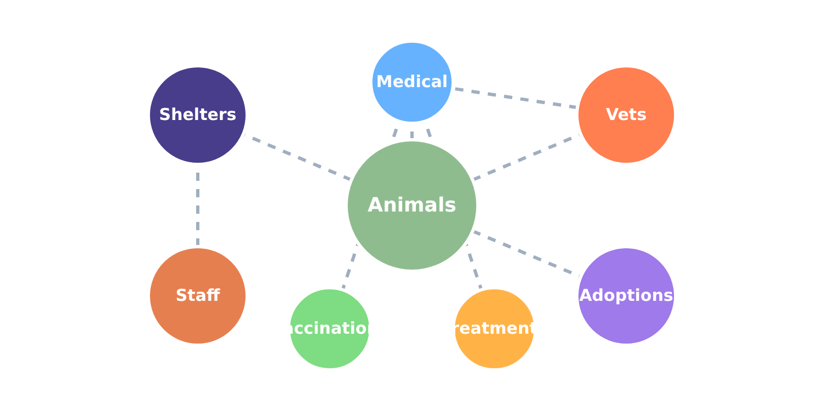



















Database Architecture Masterpiece
Core Entities
Entity Relationships
Animals
Shelters
Tracks 150+ individual animals
Multiple facility support
Veterinarians
Staff
Specialized medical professionals
Personnel management
Adoptions
Medical Records
Placement tracking
Comprehensive history
Third Normal Form Design
Eliminates data redundancy and ensures integrity
Each entity has a single responsibility
Foreign key relationships enable comprehensive tracking
Solid Foundation
This meticulously crafted architecture provides a robust foundation for all shelter operations, ensuring data integrity while supporting complex queries and transactions.
4/13

Slide 5
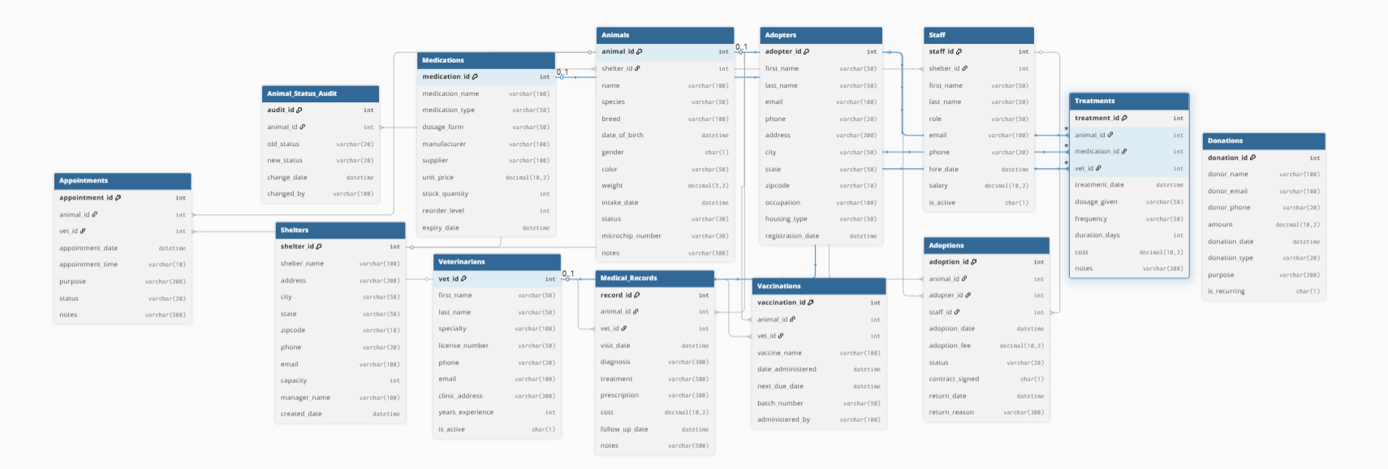

Slide 6
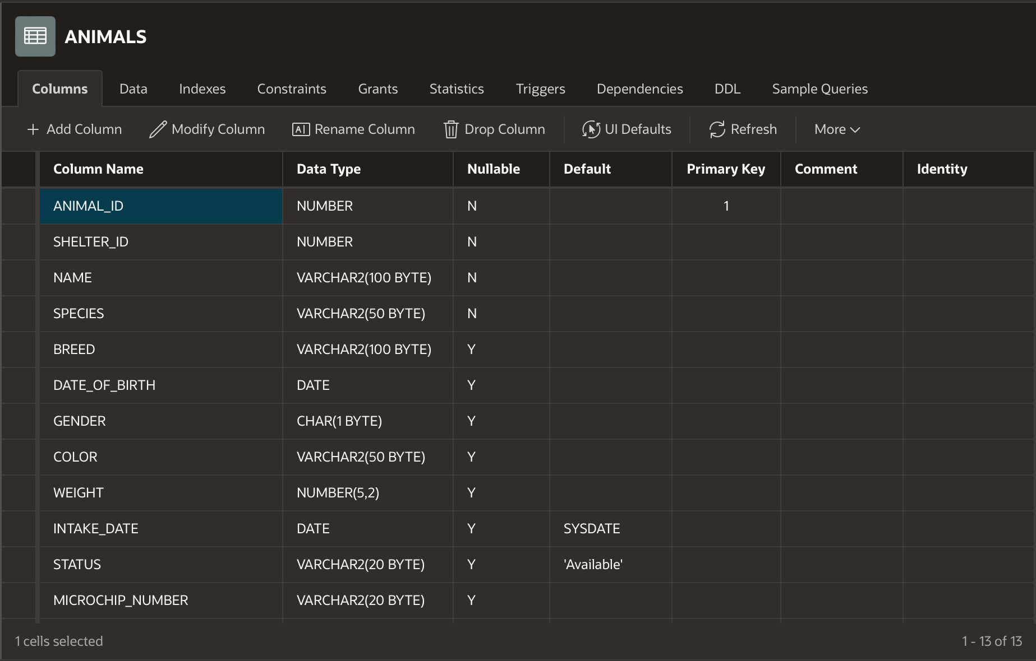
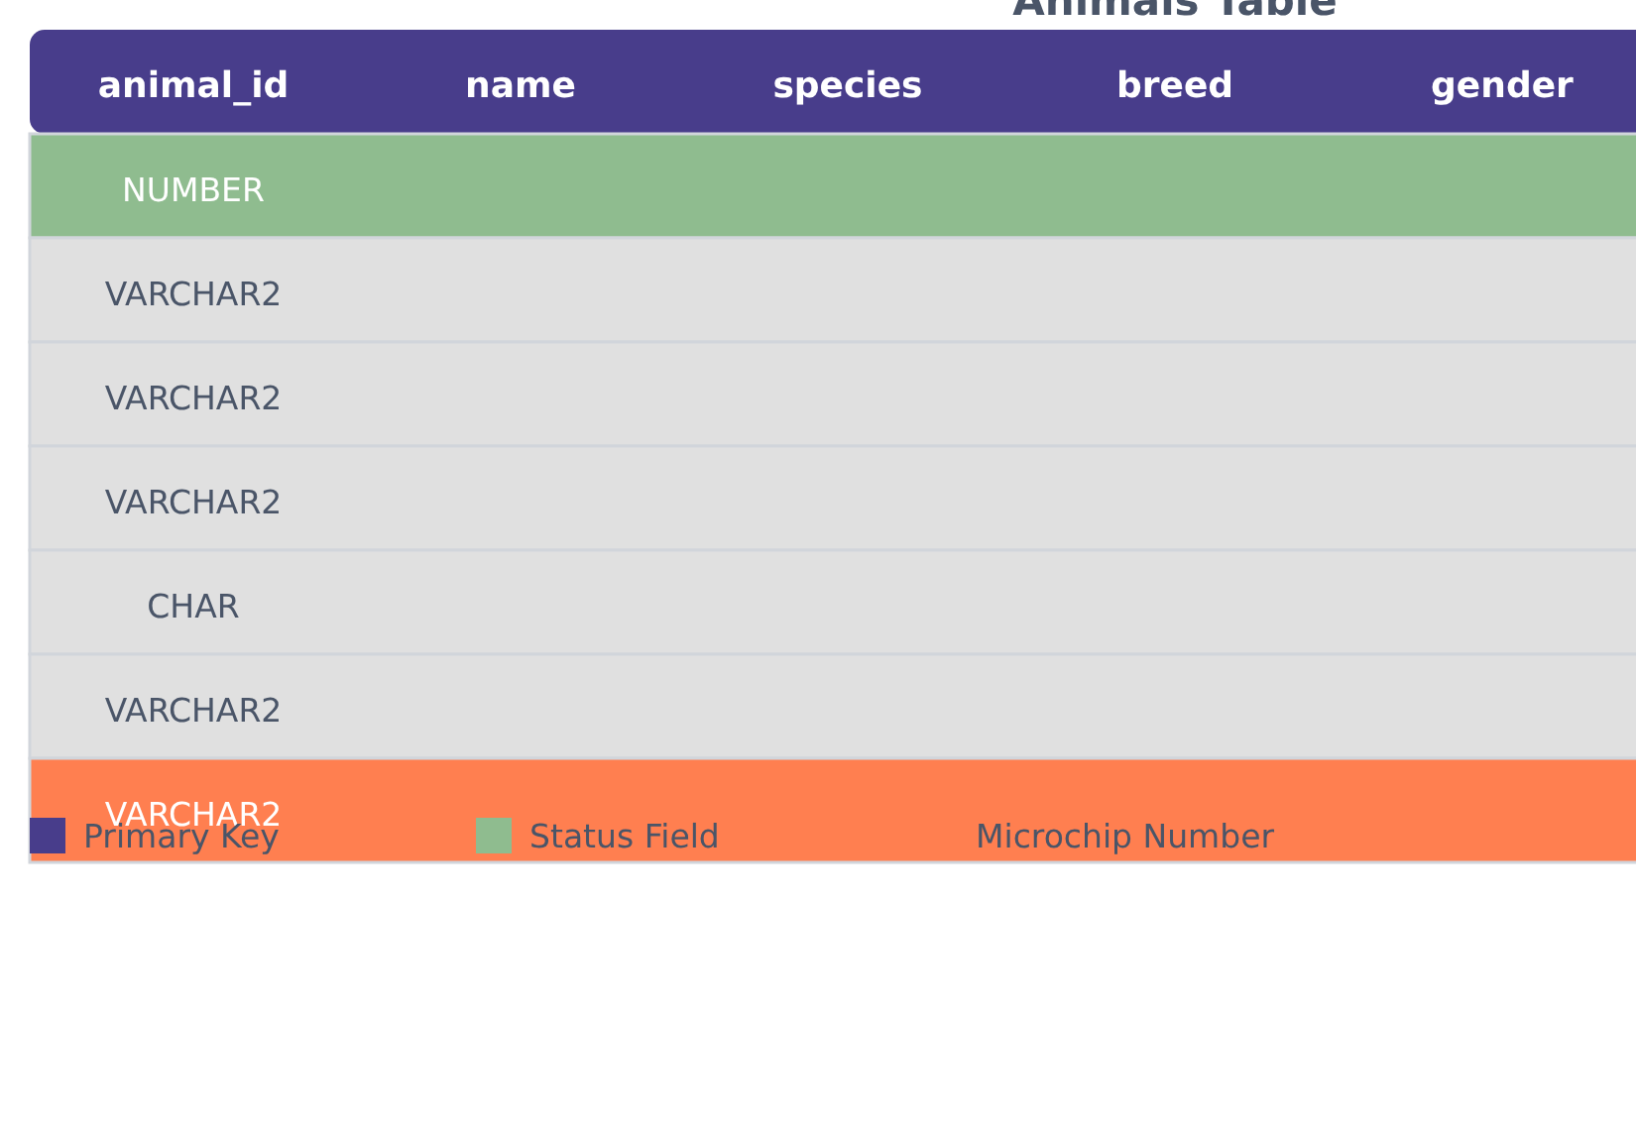








Data Integrity & Intelligent Design
Animals Table Structure
Key Data Integrity Features
Auto-increment Sequences
Primary keys are automatically generated via Oracle sequence (seq_animal), preventing duplicate IDs and ensuring sequential numbering.
Unique Microchip Validation
The microchip_number field is designated as UNIQUE, guaranteeing each animal has a distinct identifier for critical tracking.
Sophisticated Status Tracking
The status field provides real-time insight into an animal's availability and needs, directly impacting shelter operations.
Third Normal Form Design
Our database design adheres to 3NF principles, ensuring data integrity and minimizing redundancy across all tables.
5/13

Slide 7




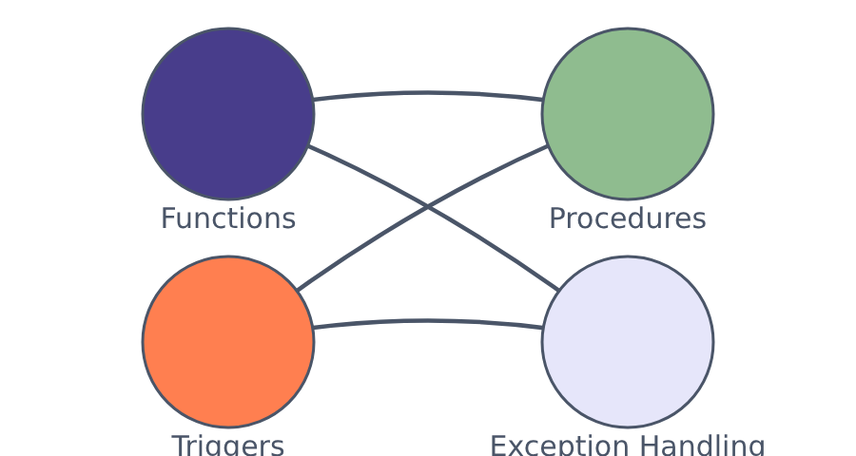








PL/SQL Excellence:
Advanced Functions
PL/SQL Integration
Custom functions encapsulating reusable business logic:
calculate_animal_age(animal_id): Returns precise age in years
Comprehensive Procedures
Stored procedures handling complex operations:
How PL/SQL components work together
add_animal_intake: Validates and registers new animals
Intelligent Triggers
Database Mastery
Automated responses to database events:
Centralized business logic enforcement
animal_status_trigger: Updates status on adoption
Automated data integrity maintenance
Complex validation at database level
Custom error handling for user feedback
Robust Exception Handling
Custom exceptions with user-friendly messages:
RAISE_APPLICATION_ERROR: "Cannot delete: Animal has active adoption"
6/13

Slide 8
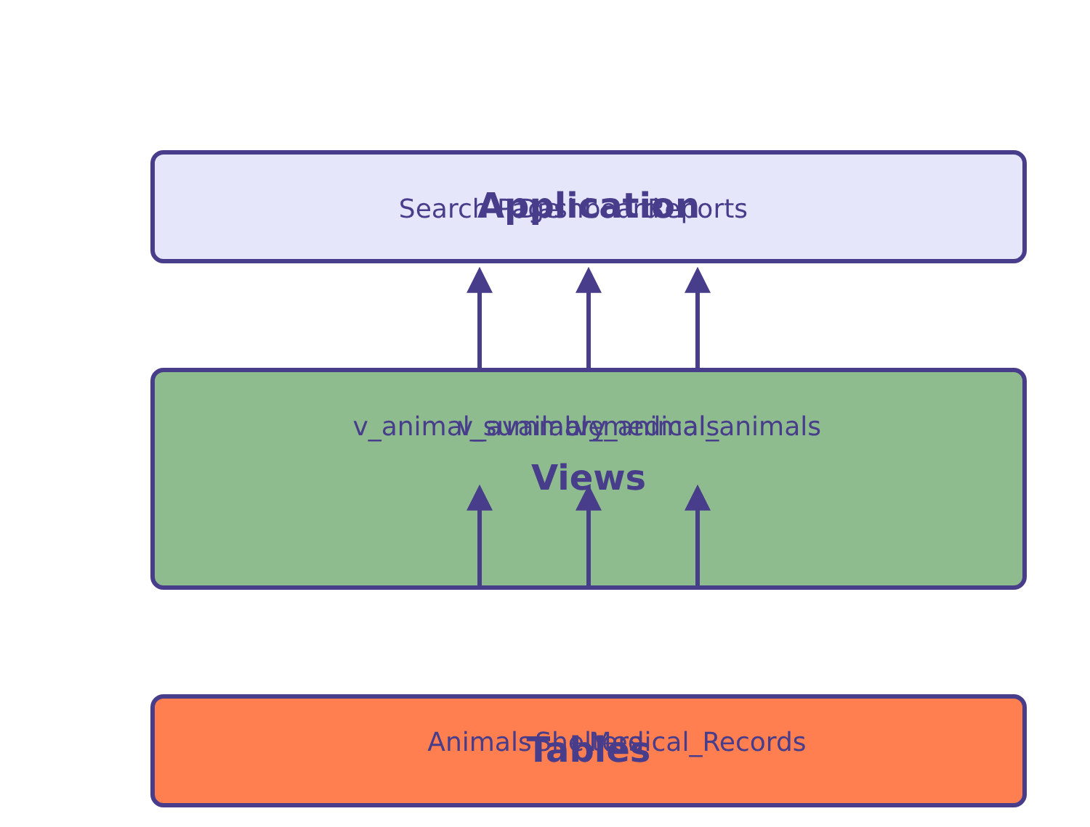














Optimized Views: Performance & Security
View Architecture
Key Benefits
Simplified Access
Enhanced Security
Abstracts complex joins and calculations, presenting data as if it were in a single table.
Restricts access to specific rows or columns, allowing role-based data visibility.
Application
Improved Performance
Maintenance
If table structure changes, only view definitions need updating.
Query optimizer can enhance execution plans for frequently used views.
Tables
Example Views
v_animal_summary
- Combines animal and shelter data
10 distinct views transform complex queries into elegant solutions, providing a virtual table interface that abstracts underlying table structure.
v_available_animals
- Filters for animals ready for adoption
v_medical_animals
- Identifies animals under medical care
7/13

Slide 9










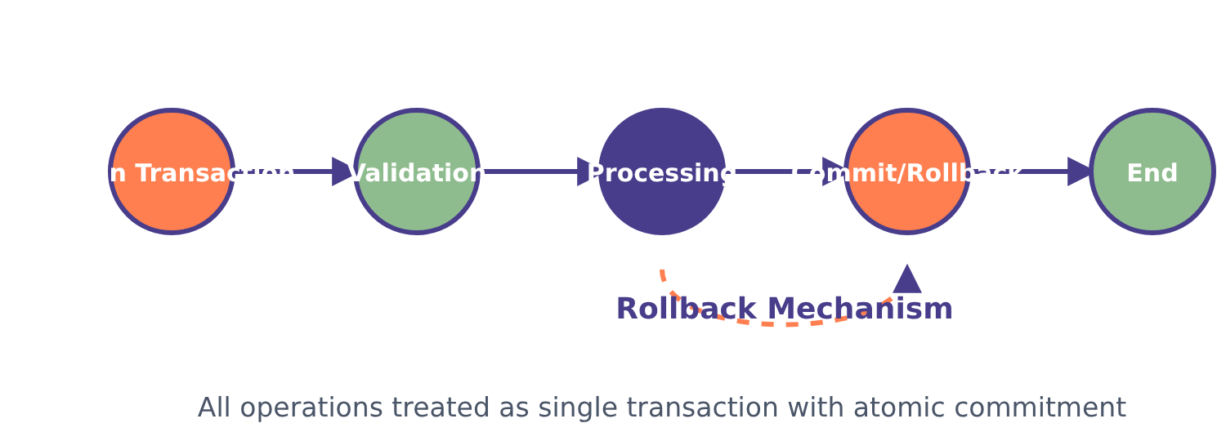





Enterprise-Grade Transaction Management
Atomicity
Consistency
Isolation
Durability
All operations within a transaction are completed as a unit or none at all.
Data integrity constraints are maintained before and after the transaction.
Concurrent transactions do not affect each other's execution.
Committed transactions survive system failures.
Transaction Flow
Key Features
Pre-Deletion Checks
System prevents deletion if active adoptions or medical care records exist.
Cascading Operations
Automatic cascade to related records ensures referential integrity.
Audit Logging
Comprehensive logging for accountability and historical tracking.
8/13

Slide 10

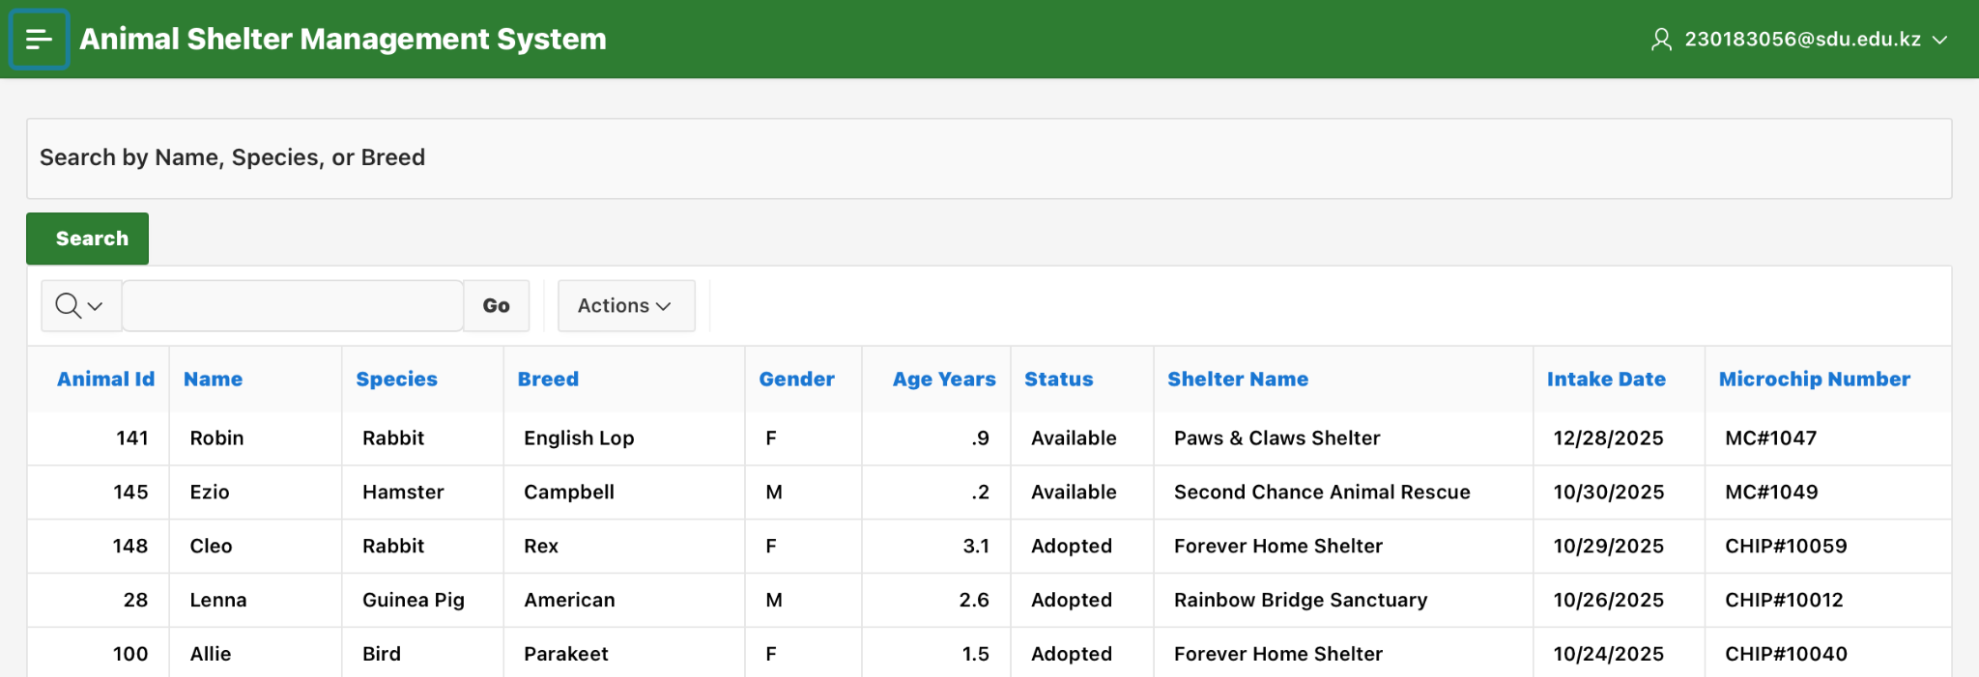









User-Friendly Search Experience
Intuitive Search Interface
Search by name, species, or breed...
Filter
Name
Species
Breed
Gender
Age
Status
Buddy
Dog
Golden Retriever
M
3
Available
Max
Dog
German Shepherd
M
2
Available
Luna
Cat
Persian
F
1
Medical Care
Real-Time Filtering
Case-Insensitive Matching
Export Capabilities
Results update instantly as you type, providing immediate feedback and reducing search time by half.
Smart algorithm ensures "dog", "DOG", and "Bulldog" all return consistent results.
One-click export to Excel for offline analysis and record-keeping.
9/13

Slide 11
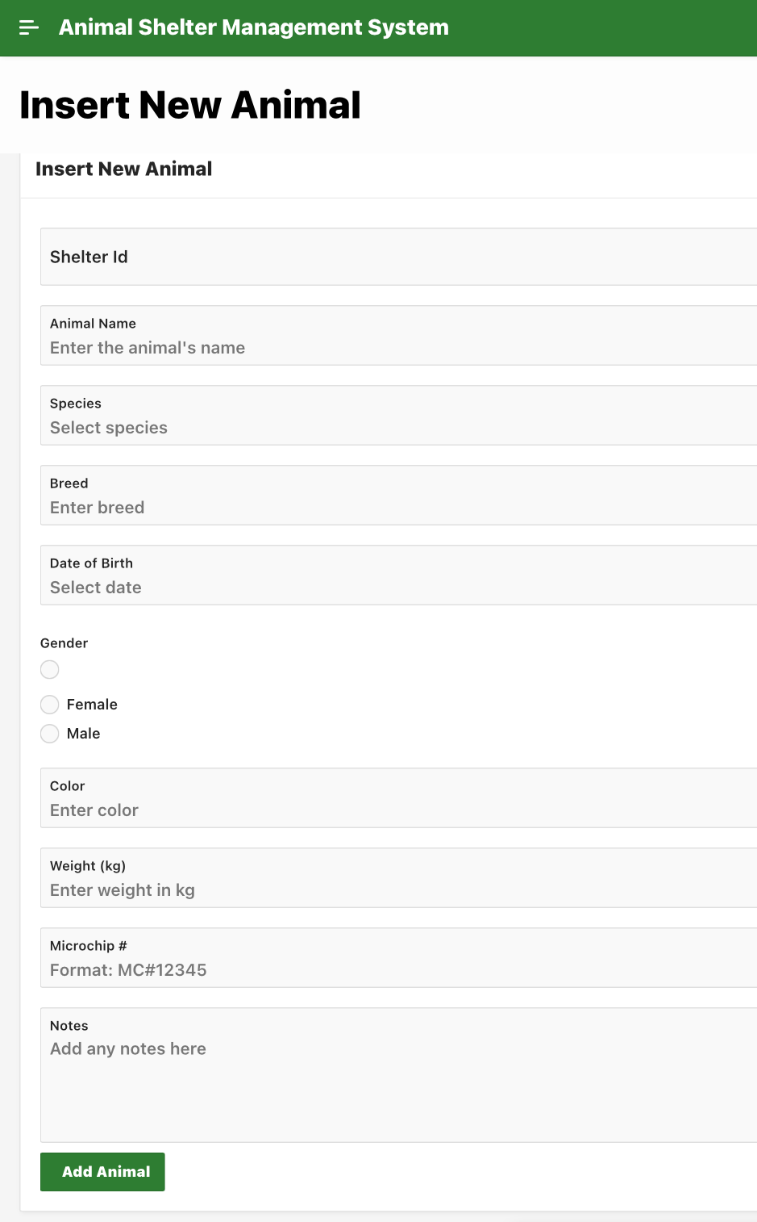


























Streamlined Data Entry Workflow
Registration Process
Intuitive Registration Form
Shelter ID *
Name *
Select Shelter...
Species *
Breed
Select species...
Client Validation
Server Validation
Real-time feedback as users enter data, preventing errors before submission.
Second layer of security checks ensure data integrity before database insertion.
Date of Birth
Gender
Male
Female
Success Experience
Intelligent Dropdowns
User-friendly Date Pickers
Multi-level Validation
"Animal added successfully!" notification confirms completion of the create operation.
10/13

Slide 12
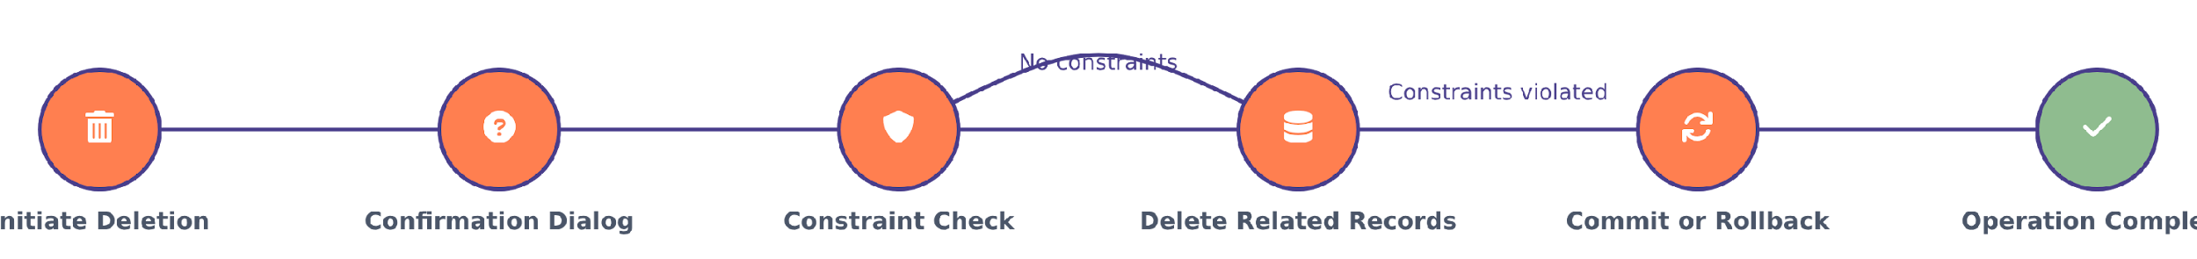







Bulletproof Deletion Process
Deletion Safety Process
Intelligent Constraint Checking
Automatic Cascade Deletion
Transaction Protection
Uses ROLLBACK on errors, guaranteeing the database remains in a consistent state.
Prevents deletion of animals with active adoptions or in medical care, maintaining data integrity.
Automatically removes all related records with a single transaction, ensuring consistency.
Additional Safety Measures
Confirmation dialog prevents accidental deletions
Clear error messages explain why deletions are blocked
Audit logs record all deletion events
Real-time status validation protects data integrity
11/13

Slide 13
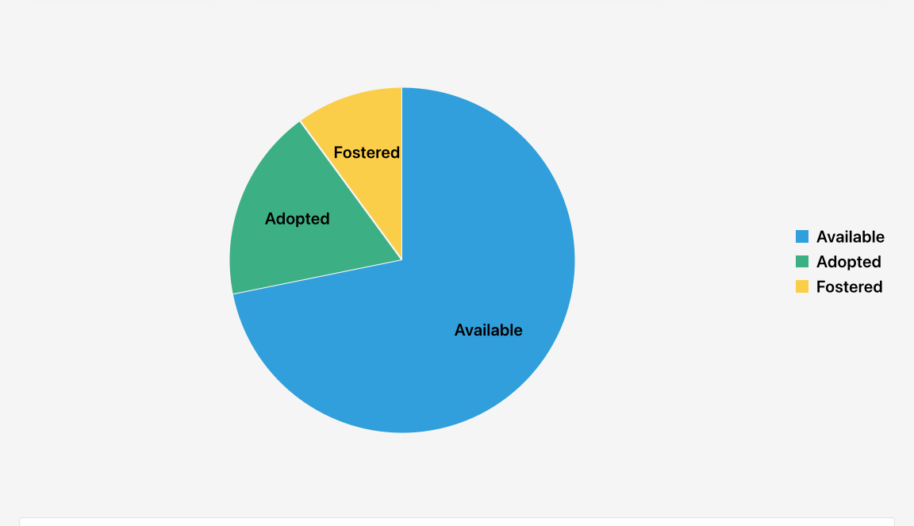
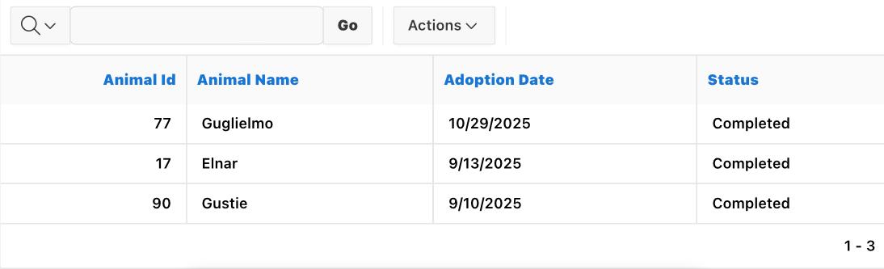



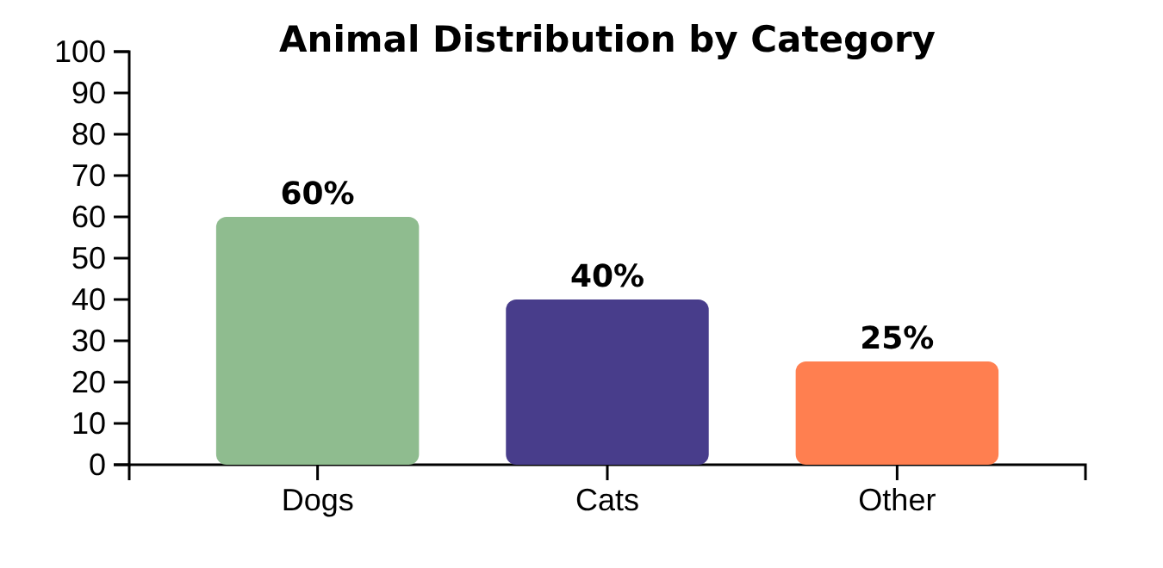














Insightful Analytics Dashboard
Key Performance Indicators
Interactive Dashboard
Total Animals
Available for Adoption
150+
42
Adoptions This Month
Donations This Month
18
$2,450
Comprehensive Reporting
Key Statistics
Medical Records
Trends by species
Vaccination Schedules
Adoption Records
Track animal status and visualize it
Detailed views of animal medical histories
View age distribution and status ratio by species
Comprehensive adoption tracking and analysis
Track vaccination status and due dates
12/13

Slide 14



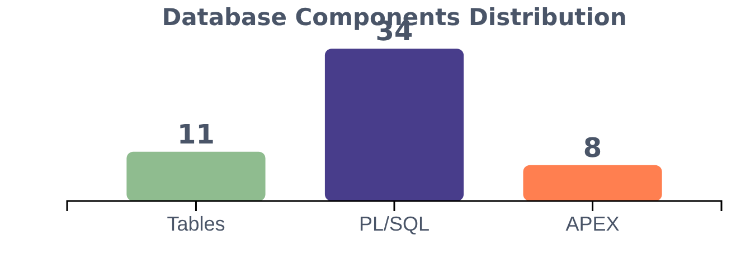









Our Team's Proud Accomplishments
Project Highlights
Component Distribution
5 Weeks of Dedication
Intensive teamwork delivering a production-ready solution
11 Normalized Tables
Design adhering to 3NF principles for data integrity
34+ PL/SQL Components
Functions, procedures, and triggers for robust business logic
Technical Excellence
Our team delivered a production-ready implementation that demonstrates both technical excellence and practical value. The system is fully functional, secure, and optimized for performance.
8 APEX Pages
Interactive interfaces for seamless user experience
Thank you for your attention!
13/13

